Slide 1
Image Data & Computer Vision
Nuffield Summer supervision project 2024

Slide 2

Contents
Digital Image Processing
What are digital images? How are they represented? How do we work with image data?
Convolutional Neural Networks (CNNs)
What are ‘CNNs’? How do we use CNNs for classification? How do we program a CNN?

Slide 3

1. Digital Image Processing

Slide 4
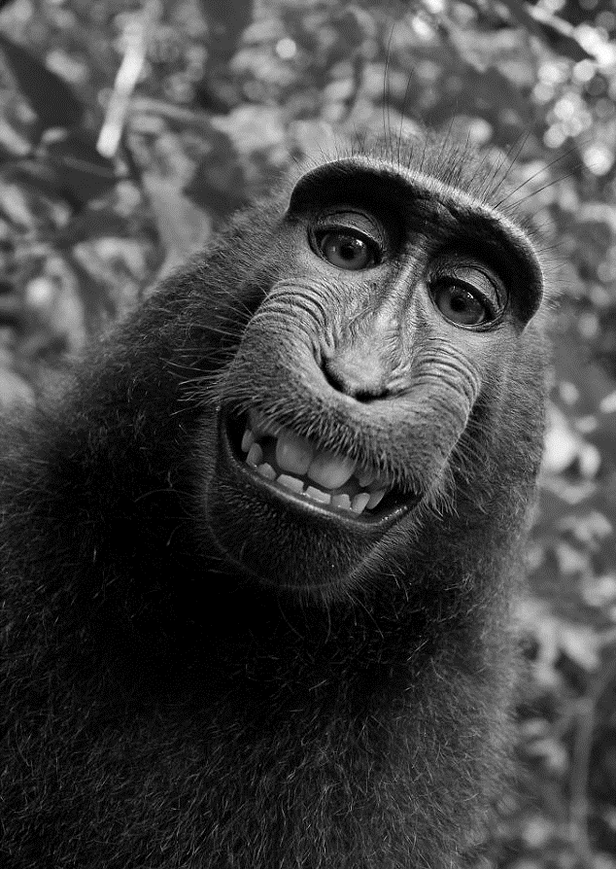
Digital Image Processing
Digital images are composed of a finite number of picture elements, or pixels.
Each pixel has a particular location and value.

Slide 5
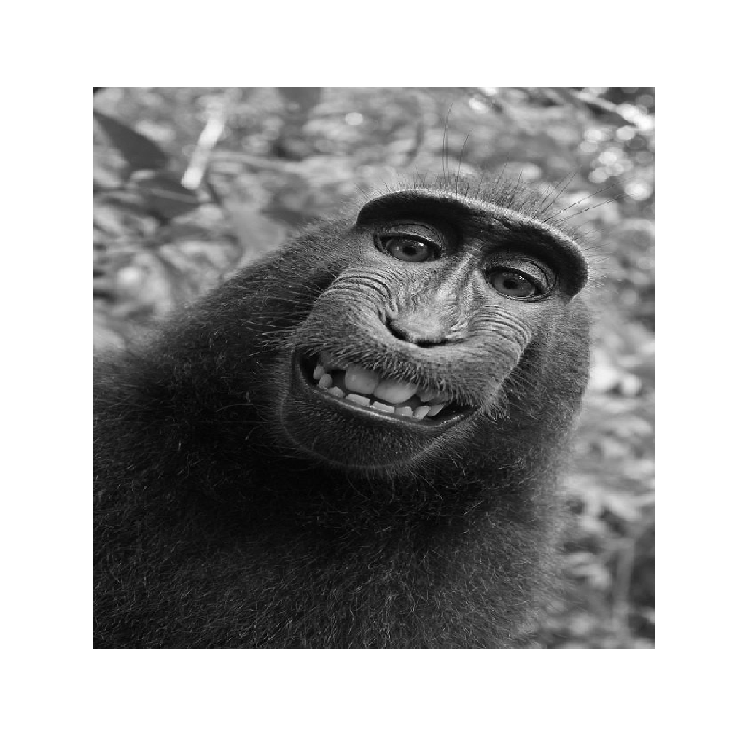

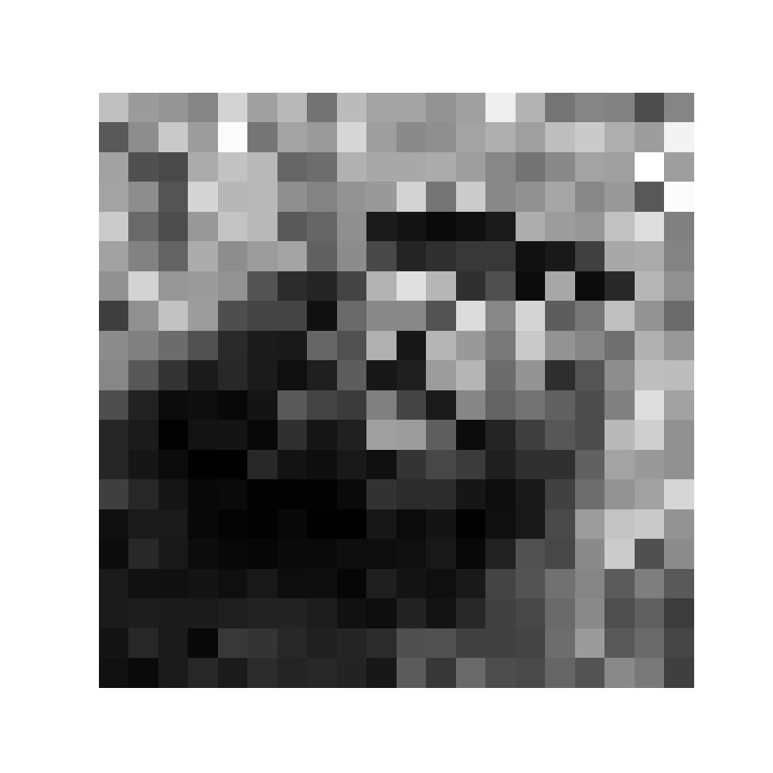
Digital Image Processing

Slide 6
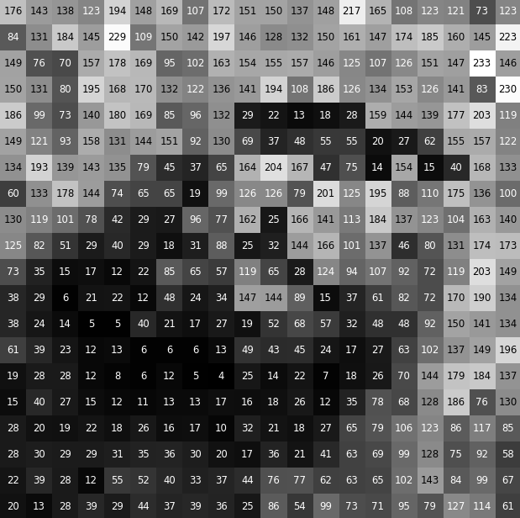
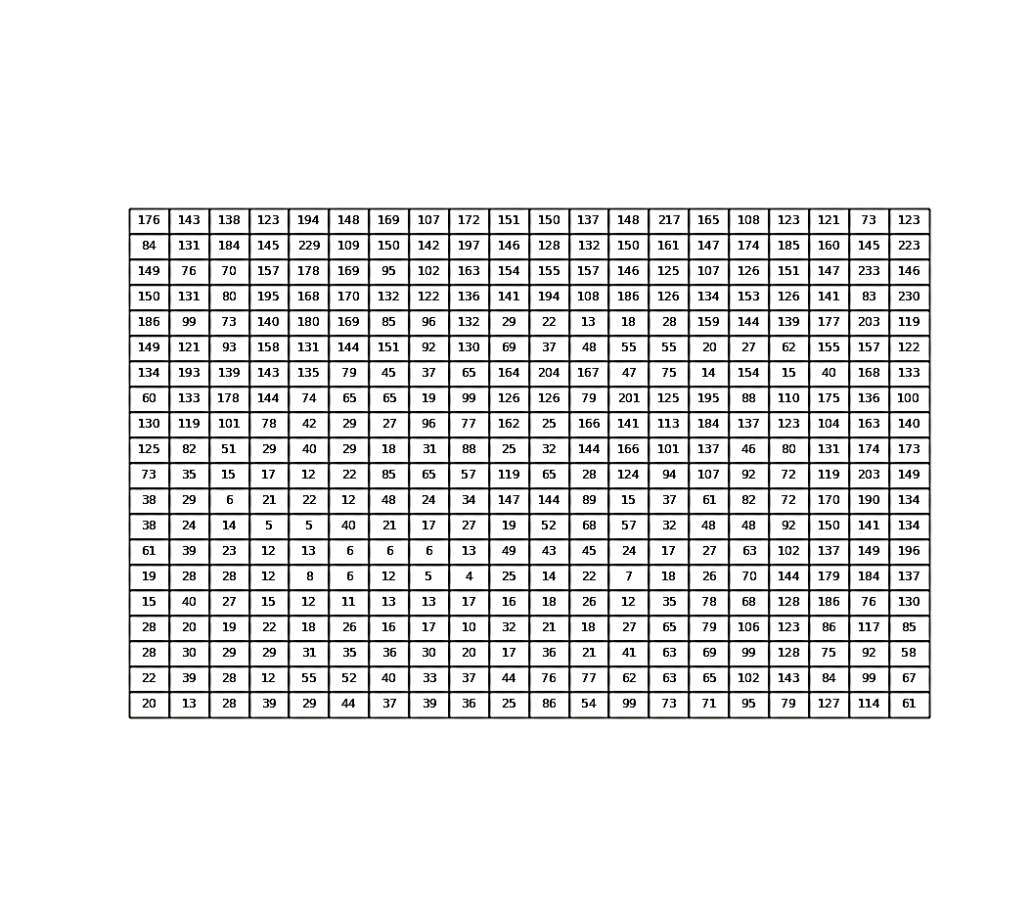
Digital Image Processing

Slide 7
Digital Image Processing
Computers cannot ‘see’ an image; they represent images mathematically (pixel values and position in coordinate space):
[[176 143 138 123 194 148 169 107 172 151 150 137 148 217 165 108 123 121 73 123] [84 131 184 145 229 109 150 142 197 146 128 132 150 161 147 174 185 160 145 223] [149 76 70 157 178 169 95 102 163 154 155 157 146 125 107 126 151 147 233 146] [150 131 80 195 168 170 132 122 136 141 194 108 186 126 134 153 126 141 83 230] [186 99 73 140 180 169 85 96 132 29 22 13 18 28 159 144 139 177 203 119] [149 121 93 158 131 144 151 92 130 69 37 48 55 55 20 27 62 155 157 122] [134 193 139 143 135 79 45 37 65 164 204 167 47 75 14 154 15 40 168 133] [60 133 178 144 74 65 65 19 99 126 126 79 201 125 195 88 110 175 136 100] [130 119 101 78 42 29 27 96 77 162 25 166 141 113 184 137 123 104 163 140] [125 82 51 29 40 29 18 31 88 25 32 144 166 101 137 46 80 131 174 173] [73 35 15 17 12 22 85 65 57 119 65 28 124 94 107 92 72 119 203 149] [38 29 6 21 22 12 48 24 34 147 144 89 15 37 61 82 72 170 190 134] [38 24 14 5 5 40 21 17 27 19 52 68 57 32 48 48 92 150 141 134] [61 39 23 12 13 6 6 6 13 49 43 45 24 17 27 63 102 137 149 196] [19 28 28 12 8 6 12 5 4 25 14 22 7 18 26 70 144 179 184 137] [15 40 27 15 12 11 13 13 17 16 18 26 12 35 78 68 128 186 76 130] [28 20 19 22 18 26 16 17 10 32 21 18 27 65 79 106 123 86 117 85] [28 30 29 29 31 35 36 30 20 17 36 21 41 63 69 99 128 75 92 58] [22 39 28 12 55 52 40 33 37 44 76 77 62 63 65 102 143 84 99 67] [20 13 28 39 29 44 37 39 36 25 86 54 99 73 71 95 79 127 114 61]]

Slide 8
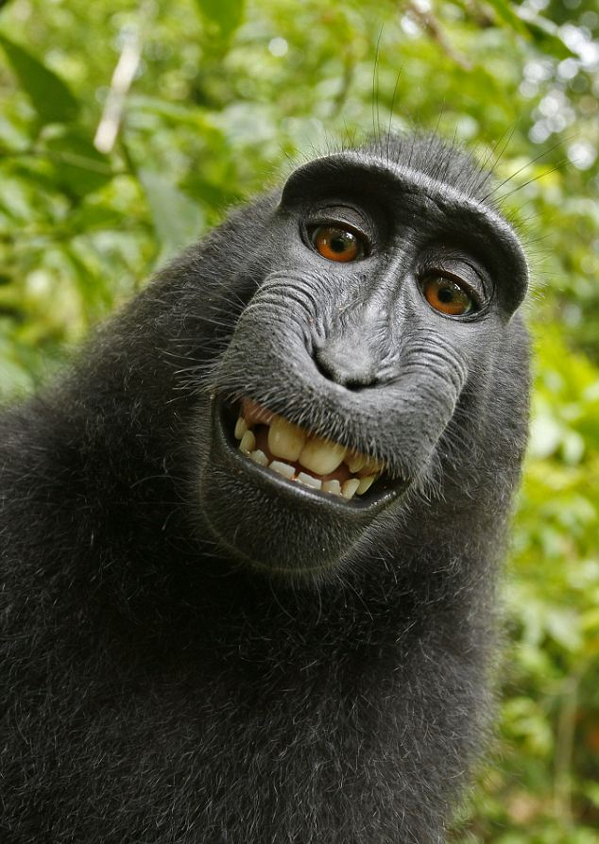
Digital Image Processing
Digital images are composed of a finite number of picture elements, or pixels.
Each pixel has a particular location and value.

Slide 9
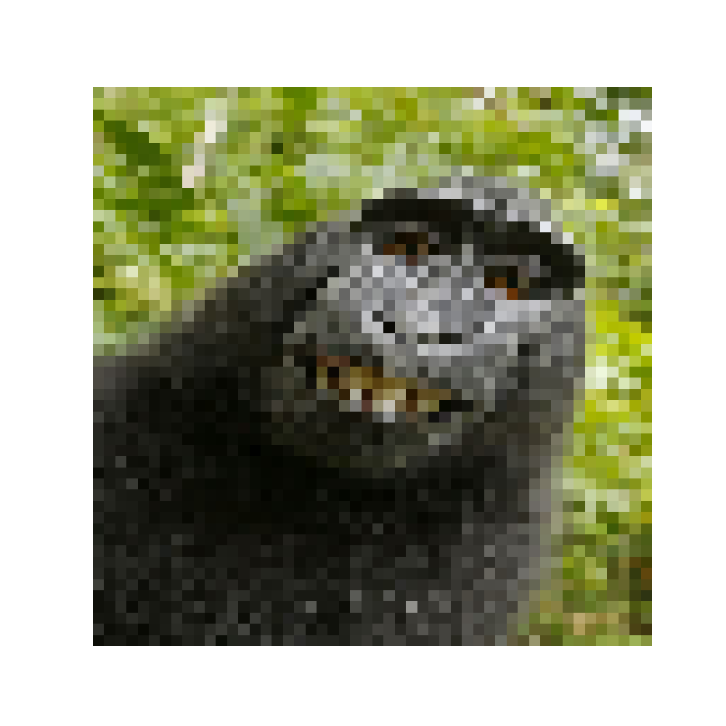

Digital Image Processing

Slide 10

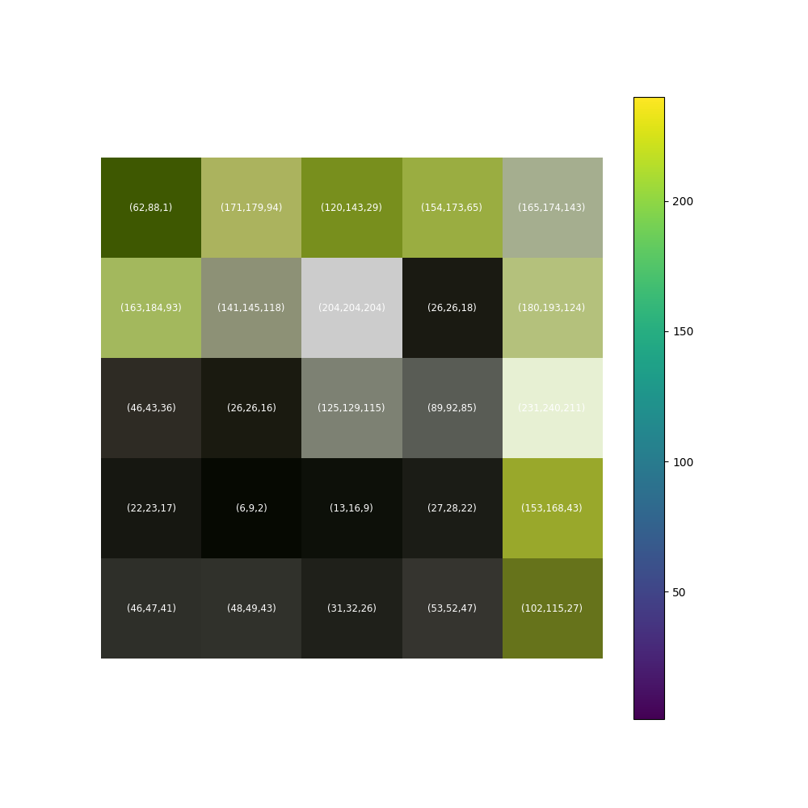
Digital Image Processing

Slide 11
Digital Image Processing
[[[ 62 88 1]
[171 179 94]
[120 143 29]
[154 173 65]
[165 174 143]]
[[163 184 93]
[141 145 118]
[204 204 204]
[ 26 26 18]
[180 193 124]]
[[ 46 43 36]
[ 26 26 16]
[125 129 115]
[ 89 92 85]
[231 240 211]]
[[ 22 23 17]
[ 6 9 2]
[ 13 16 9]
[ 27 28 22]
[153 168 43]]
[[ 46 47 41]
[ 48 49 43]
[ 31 32 26]
[ 53 52 47]
[102 115 27]]]

Slide 12
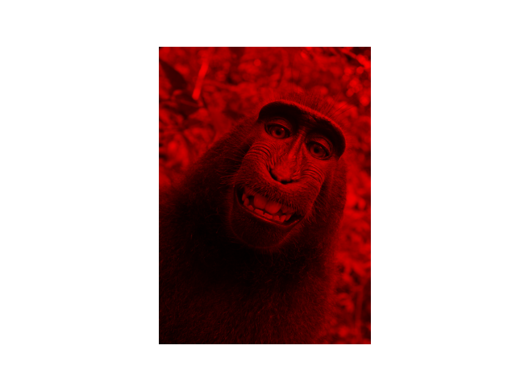
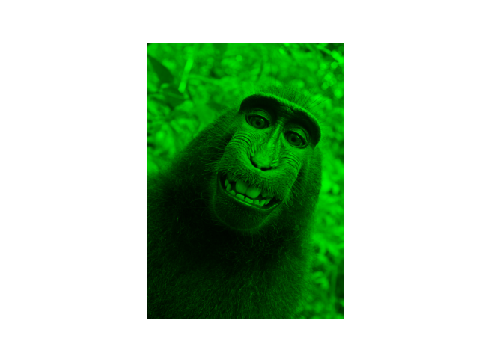
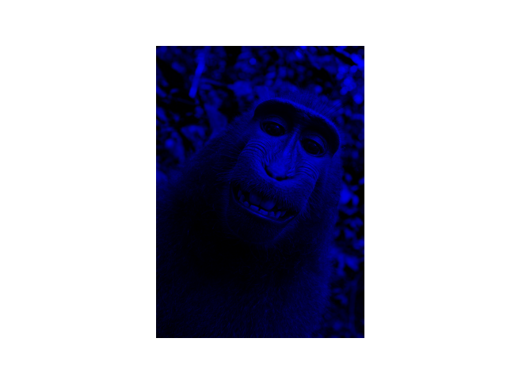
Digital Image Processing

Slide 13
Digital Image Processing

Slide 14

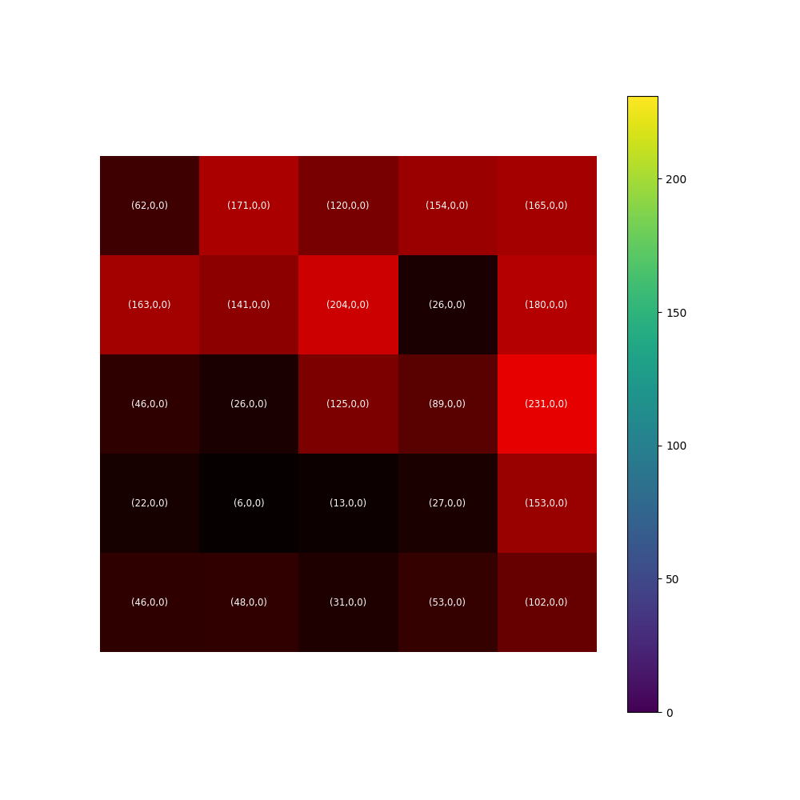
Digital Image Processing

Slide 15
Digital Image Processing
[[[ 62 0 0]
[171 0 0]
[120 0 0]
[154 0 0]
[165 0 0]]
[[163 0 0]
[141 0 0]
[204 0 0]
[ 26 0 0]
[180 0 0]]
[[ 46 0 0]
[ 26 0 0]
[125 0 0]
[ 89 0 0]
[231 0 0]]
[[ 22 0 0]
[ 6 0 0]
[ 13 0 0]
[ 27 0 0]
[153 0 0]]
[[ 46 0 0]
[ 48 0 0]
[ 31 0 0]
[ 53 0 0]
[102 0 0]]]

Slide 16
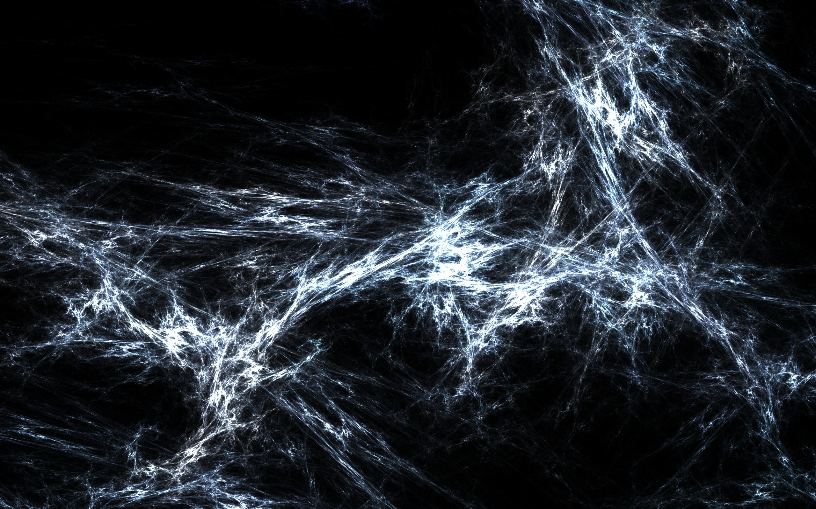
2. Convolutional Neural Networks (CNNs)

Slide 17
CNNs
The Convolutional Neural Network (CNN) is a deep learning architecture that performs efficiently in the domain of ‘visual’ tasks; i.e. tasks that use visual/spatial data.
CNNs are inspired by the visual perception of living beings; they are inspired specifically by the following basic features:
Layered Abstraction; visual patterns are recognised by extracting local features and then combining said features for higher level representations.
Local Region Connections; the neurons in each ‘layer’ of the [mammalian] brain are connected and they represent some set of features.
Spatial Invariance; this results in an equally shifted output signal under a variety of conditions.

Slide 18
CNNs
Object
Monkey
Highest Abstraction
High-Level Features
Mouth, Eyes
Higher Abstraction
Low-Level Features
Edges, Lines, Shapes
Lower Abstraction
Image

Slide 19
CNNs
Monkey
Cat
Giraffe
Elephant
Convolution
Pooling
Convolution+ Pooling x2+
Flatten
Fully Connected
Softmax
Feature Learning
Classification

Slide 20
CNNs
[[n, n, n, n, … n],
[n, n, n, n, … n],
[n, n, n, n, … n],
[n, n, n, n, … n],
[n, n, n, n, … n],
[n, n, n, n, … n],
[n, n, n, n, … n],
[n, n, n, n, … n],
[n, n, n, n, … n],
[n, n, n, n, … n],
[n, n, n, n, … n],
[n, n, n, n, … n]]
Input Image
Digital Images are Mathematical Objects!
Matrix of Pixel Values

Slide 21
Convolution

Slide 22
Convolution
Movement of kernel is called its
‘stride’; in our case the stride = 1
21
22
12
48
24
21
22
12
48
24
5
5
40
21
17
5
5
40
21
17
12
13
6
6
6
12
13
6
6
6
12
8
6
12
5
12
8
6
12
5
15
12
11
13
13
15
12
11
13
13
1
0
1
19
97
51
0
1
0
44
30
50
-1
-1
1
10
38
13
Input Image; we will take a small region for demonstrative purposes.
Kernel / Filter
(3x3)

Slide 23
Convolution
0
0
0
0
0
0
0
21
22
12
48
24
0
21
22
12
48
24
0
5
5
40
21
17
0
5
5
40
21
17
0
12
13
6
6
6
0
12
13
6
6
6
0
12
8
6
12
5
0
12
8
6
12
5
0
15
12
11
13
13
0
15
12
11
13
13
0
0
0
0
0
0
0
0
1
0
1
We may also add padding to the image (zeros around the outside); padding helps preserve the size of feature maps.
0
1
0
Input Image; we will take a small region for demonstrative purposes.
-1
-1
1
Kernel / Filter
(3x3)

Slide 24
Convolution
21
22
12
48
24
19
97
51
5
5
40
21
17
12
13
6
6
6
44
30
50
12
8
6
12
5
10
38
13
15
12
11
13
13
Feature Map
1
0
1
Feature Map = D – F + 2P + 1
0
1
0
S
-1
-1
1
D = size of the image.
F = size of the kernel / filter.
P = amount of padding.
S = stride length
Input Image; we will take a small region for demonstrative purposes.
Kernel / Filter
(3x3)

Slide 25
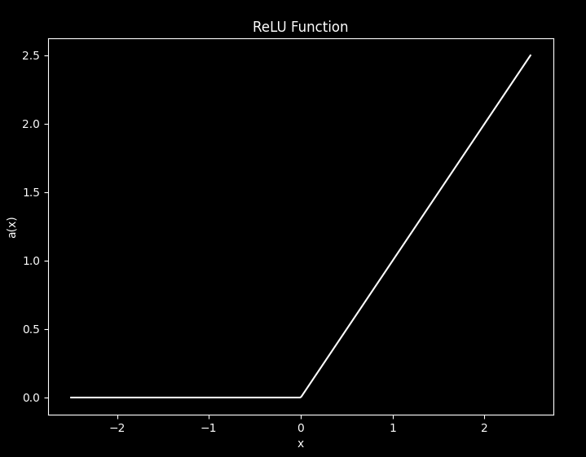
Convolution
19
97
51
19
97
51
44
30
50
44
30
50
10
38
13
10
38
13
Feature Map
Output from Convolutional Layer
Feature Map = D – F + 2P + 1
S
D = size of the image.
F = size of the kernel / filter.
P = amount of padding.

Slide 26
Pooling

Slide 27
Pooling
The pooling layer sub-samples the feature maps (output produced after convolution layer).
Pooling reduces the overall count of parameters in the network as well as the complexity involved.
Common pooling techniques involve:
Max Pooling; the maximum value is extracted.
Average Pooling; the minimum value is extracted.
Min Pooling; the average value is extracted.

Slide 28
19
97
51
19
97
51
19
97
51
97
47.5
19
Step 1
44
30
50
44
30
50
44
30
50
10
38
13
10
38
13
10
38
13
19
97
51
19
97
51
19
97
51
97
97
47.5
57
19
13
Step 2
44
30
50
44
30
50
44
30
50
10
38
13
10
38
13
10
38
13
19
97
51
19
97
51
19
97
51
19
97
47.5
57
19
13
Step 3
44
30
50
44
30
50
44
30
50
44
30.5
10
10
38
13
10
38
13
10
38
13
19
97
51
19
97
51
19
97
51
19
97
47.5
57
19
13
Step 4
44
30
50
44
30
50
44
30
50
44
50
30.5
32.75
10
13
10
38
13
10
38
13
10
38
13
Max Pooling
Average Pooling
Min Pooling

Slide 29
Fully-Connected Layer

Slide 30
Fully-Connected Layer
The classification stage of a CNN architecture is much more akin to the ANN architectures you have already seen; a fully-connected layer.
Inputs to this stage are initially flattened; i.e. are transformed into a 1D vector.
Each neuron inside a dense layer is connected to each neuron from the previous layer.
The final layer (output layer) is typically a classifier; the output of the CNN is classified, typically with a SoftMax activation function.

Slide 31
CNNs
Monkey
Cat
19
97
[19, 97, 44, 50]
Giraffe
44
50
Elephant
Input
Flatten
Softmax

Slide 32
Don’t Panic!

Slide 33
We have just covered a complex, novel, and industry standard architecture; you are not expected to understand everything at first glance!
Use this presentation as a reference should you need to.
Importantly, this presentation will assist you in finding the parameters / optimisations you will make to a CNN during your own project!

Slide 34
Parameters
CNN
Kernel Size; typical sizes are 3x3, 5x5, and 7x7 (think about the size of the images you use!).
Stride Length; typical lengths are 1 and 2.
Padding; padding is usually 1 (what advantages would changing it have? When should you use padding vs. when should you not?).
Activation Function; we covered ReLU, which is standard (how do different activation functions affect results?).
Pooling; Will you use Max, Average, or Min pooling? What does changing your pooling technique do the results you obtain?
Weight Initialisation; standard to use ‘random initialisation’ (can you find any other CNN weight initialisation techniques through your own research that may improve your model? What are the disadvantages of random initialisation? Hint… we want to avoid what are known as vanishing gradients and exploding gradients).

